Slide 1
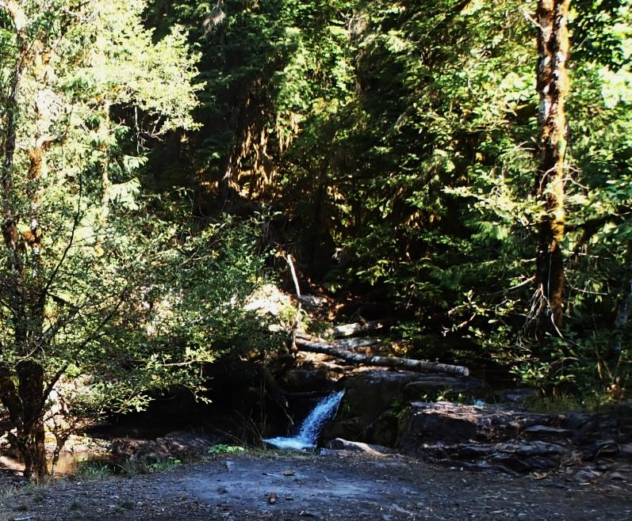


Spawning success of spring Chinook salmon in Fall Creek, the North Fork Middle Fork Willamette and South Santiam, 2008-2014
Matthew Keefer¹, George Naughton¹, Christopher Caudill¹,
Tami Clabough¹, Greg Taylor² , Matt Knoff¹, Cameron Sharpe³
Grant Brink¹, Tim Blubaugh¹, & Mark Morasch¹
¹University of Idaho, ²USACE, ³ODFW

Slide 2

Acknowledgements
ODFW
  Dan Peck, Tim Wright, Ben Clemens, Tom Friesen, Naomi Halpern, Reed Fischer, Kirk Schroeder, Brett Boyd, Greg Grenbemer, Justin Huff, Mike Sinnott, Dave Metz, Amy Anderson, Katurah Soule, Shawn Brady, Charles Chamberlain, James Doyle, Keenan Smith
USACE
  Dave Griffith, Doug Garletts, Chad Helms,
  Todd Pierce, Nat Erickson, David Griffith,
  Bob Wertheimer, Rich Piaskowski
OSU
  Carl Schreck, Rob Chitwood, Mike Colvin, Courtney Danley, Mike Kent
UI
  Mike Jepson, Dan Joosten, Kal Johnson, Charlie Erdman, Tracy Bowerman

Slide 3
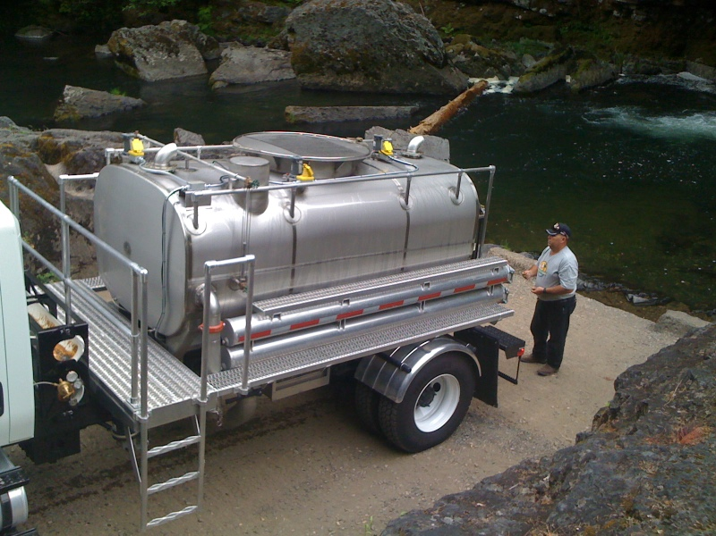
Background: Adult outplant program
Collect returning adult Spring Chinook at traps and hatcheries in WIL tributaries
Outplant ‘surplus’ fish above (and below) dams
  Restore ecological function (i.e., nutrients, prey base)
  Supplement natural Chinook production
  Re-establish self-sustaining populations
‘Trap and Haul’ by truck

Slide 4
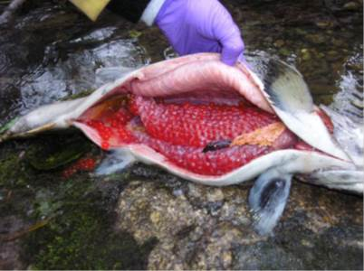
Background: Prespawn mortality
Adult Chinook PSM is a regional issue
  Temperature-mediated mortality
  Disease, density-dependent effects
WIL spring Chinook have relatively high PSM
450 site years, 8 agencies, 3 ESUs
Bowerman, Caudill, Keefer in prep
Notes:
When we looked at PSM rates across each of five separate areas within the interior Columbia River Basin, PSM rates ranged from 0 to nearly 1, but rates were highly variable over time and among streams within each area. For reference, here is the line at 25% PSM that could result in dramatic population declines over 30 years, and you can see that a few populations occasionally reached that threshold 75% PSM.
Change “Results” to something else. Add Tracy’s name to slide

Slide 5
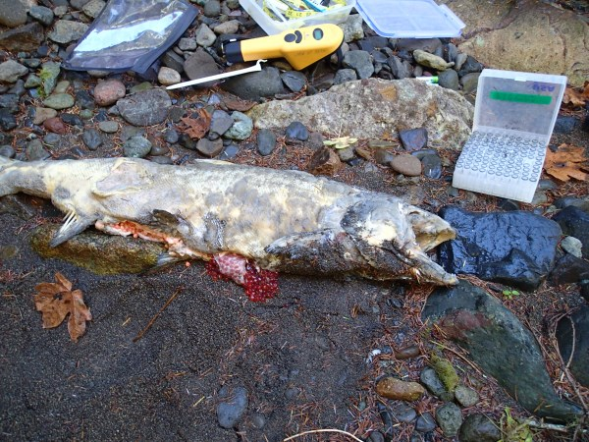
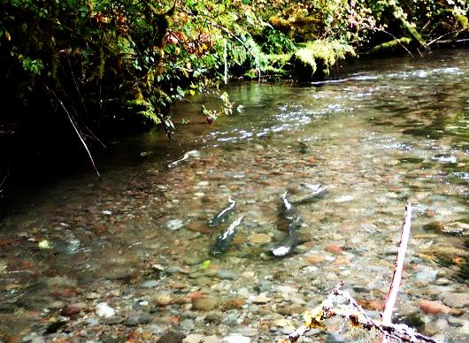
2008-2014 WIL tributary objectives
• Monitor prespawn mortality
- Radiotelemetry, PIT tags
• Assess covariates
  - Fish traits (size, sex, condition, timing, etc.)
  Temperature exposure at
  outplant sites
  Disease (Schreck, Kent et al.)
• Advise on adult collection,
transport, & outplanting
protocols: reduce PSM
Notes:
DELETE. Move pictures

Slide 6
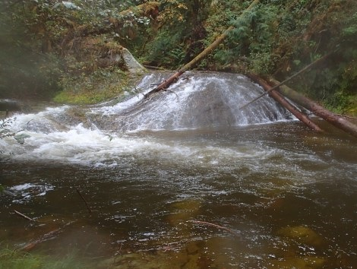
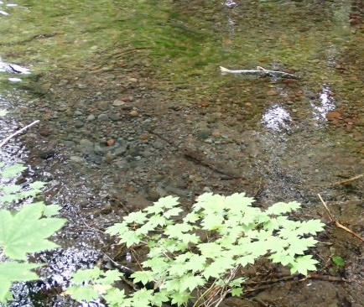
2014-specific objectives
    Fall Creek, NF Middle Fork, S Santiam
      Tagging, SG surveys
      PSM estimates
    Inter-annual patterns
      Fall Creek, NFMF
    Foster Reservoir releases
      Thermal refuge
    Minto radio-tagging
      Fallback behavior
      Movement to Big Cliff
Not PSM-related
Notes:
Updated this slide.

Slide 7
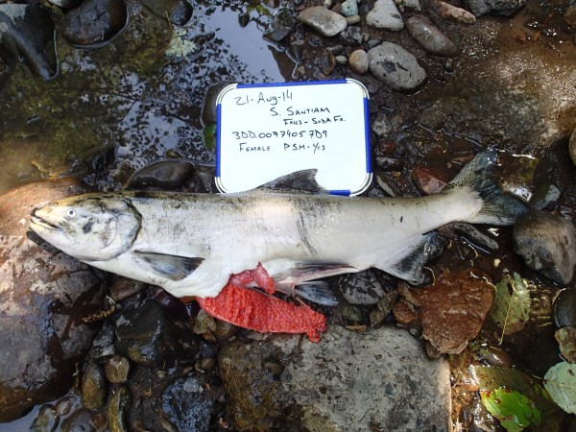
Methods: Spawning ground surveys
Mobile and fixed-site receivers used to monitor
radio-tagged salmon
June to October carcass surveys
  Joint effort by UI and ODFW
Carcasses scanned for PIT and radio tags
Spawning success assessed
  Focus on females
  Male PSM more difficult
Notes:
DELETE

Slide 8
2014 Fall Creek PIT tagging
Fall Creek Reservoir
Fish Barrier
Portland Creek
Johnny Creek
Release site
Notes:
No radio tag fish in 2014. Untagged=outplants

Slide 9
Fall Creek – Release site temperatures
Means: 1 Jul – 15 Sept
Notes:
Temperature in parentheses is mean daily temperature for each year July 1 to Sep 15

Slide 10
2014 Dexter radio & PIT tagging
Kiahanie
Release site: NF Middle Fork
Release site
1944 Bridge
Skookum Creek
Notes:
The NFMF radio telemetry site was not installed in 2014

Slide 11
NFMF – Release site temperatures
Means: 1 Jul – 15 Sept
2013 Fall floods:
Limited carcass
collection
Notes:
Temperature in parentheses is mean daily temperature for each year July 1 to Sep 15

Slide 12
2014 PIT and radio recovery rates
 | # Released |  | # Recovered on SG |  | % Recovered on SG
Location | PIT | Radio | PIT | Radio | PIT | Radio
Fall Creek | 160 | 0 | 9 | ─ | 5.6% | ─
NFMF | 150 | 50 | 30 | 9 | 20.0% | 18.0%
SF Santiam
SF (Foster Res)
    Includes males and females
Notes:
Combined Recovery Rates need to be updated
Updated. Move to main talk

Slide 13
2014 Female prespawn mortality (PSM)
 | Females recovered |  | PSM |  | % PSM
Location | PIT | Radio | PIT | Radio | PIT | Radio | Total
Fall Creek | 6 | ─ | 5 | ─ | 83% | ─ | 83%
NFMF | 19 | 3 | 4 | 0 | 21% | 0 | 18%
SF Santiam
SF (Foster Res)

Slide 14
Fall Creek cumulative PSM%
● ALL tagged and untagged Female carcasses
2009
n = 27
2012
n = 6
First redd date
● Majority of PSM was prior to redd building in all years
2010
n = 35
2013
n = 15
2011
n = 13
2014
n = 16
Notes:
Includes all marked and unmarked all radio, PIT and unmarked combined Females only

Slide 15
NFMF cumulative PSM%
● ALL tagged and untagged Female carcasses
2009
n = 10
2012
n = 48
First redd date
● Majority of PSM was prior to redd building
(except in 2011)
2010
n = 76
2013
n = 49
2011
n = 42
2014
n = 11
Notes:
Includes all marked and unmarked all radio, PIT and unmarked combined Females only

Slide 16
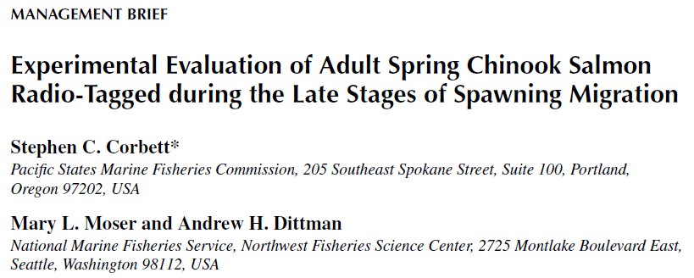
Numbers above bars = F mortalities
PSM × tag type
Females only
  Untagged
  PIT-tagged
  Radio-tagged
None: 55%
PIT: 63%
RT: 55%
None: 33%
NAJFM 32:853-858
PIT: 26%
RT: 53%
Notes:
Females only samples size are number of PSM not total found

Slide 17
Multi-year analyses
NFMF vs Fall Creek
  Stream temperature
  appears to be the
  primary driver
Fall Creek models
  Year effects
  Large fish, lower survival
NFMF models
  Few statistically
  significant covariates
  late date = ▲mortality
Notes:
Female only PIT and radio combined PSM %. No significant predictors in NFMF. Nf includes small # of H-held fish

Slide 18
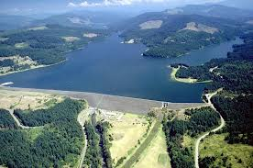
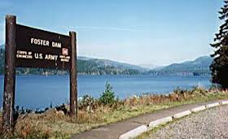
Foster Reservoir release study
Do salmon use hypolimnetic refuge
prior to tributary entry?
Notes:
I moved this from the Fall Creek/NFMF section

Slide 19
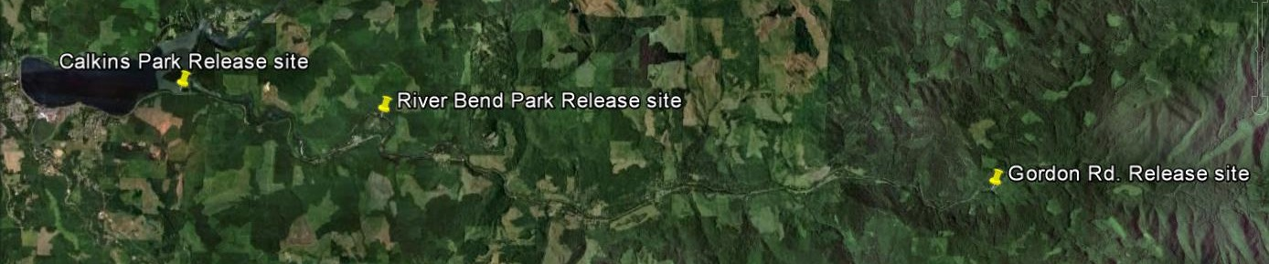
South Fork Santiam releases
Some radio-tagged fish
had temperature loggers
‘Untagged’ =
ODFW PIT tags
44
4
Foster Reservoir
126
Notes:
Note we called the other fish outplants because they are not “untagged” ODFW PIT tags all the outplants

Slide 20
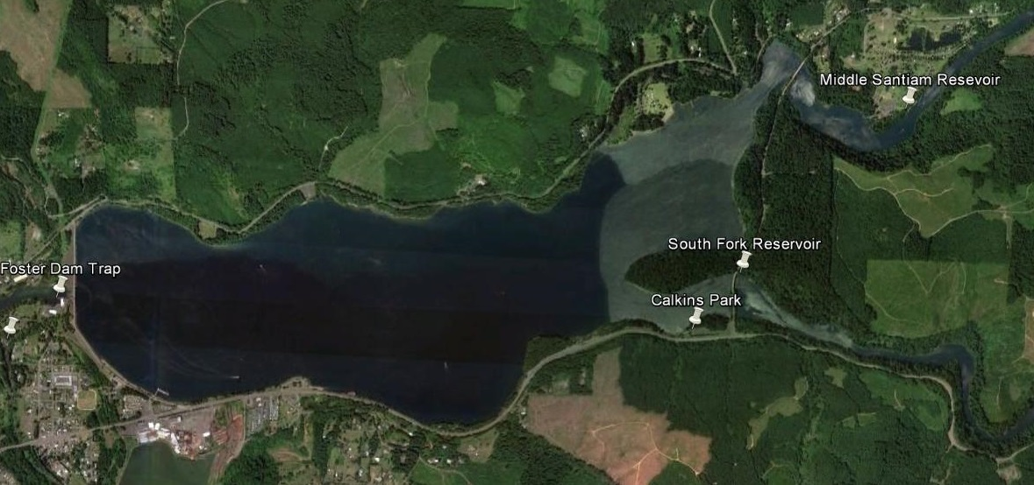
Receiver sites near Foster
MSR Receiver Site
SFR Receiver Site
Caulkins Release Site

Slide 21
Behaviors in Foster (n = 44)
Reservoir residency estimates (n = 27)
● 23% (10/44) fell back
● Median release-fallback = 3.2 d
(range 0.6 - 31.6 d)
Median residence = 11.4 d
● Evidence for both holding and wandering behaviors
Median = 12.8 d
Notes:
10 Fish fellback however all moved upstream after release at Calkins to at least SFR, 7 of 10 fell back before first redd date Sep 2 for S. Fork Santiam, 2013 6/50 (12%) fallback Calkins releases

Slide 22
Reservoir & river temperatures
Foster Reservoir
(USACE FOS_S1 Temperature String)
South Fork and Middle Santiam River sites upstream from reservoir

Slide 23
Salmon temperature in Foster
Fish 14-20: 77 days in reservoir
Notes:
Fish’s mean temperature while in reservoir was 13.97 C

Slide 24
Thermal benefit of reservoir release
Mean benefit = 2.8 degree days/d
Mean benefit = 56 Total degree days / fish
● Data from 8 fish with recovered thermal loggers
Notes:
Tributary temperatures based on Gordon Rd temperature logger site. Duration in reservoir compared to if fish were released in trib during same time period.

Slide 25
2014 PIT and Radio recovery rate
 | # Released |  | # Recovered on SG |  | % Recovered on SG
Location | PIT | Radio | PIT | Radio | PIT | Radio
Fall Creek | 160 | 0 | 9 | ─ | 5.6% | ─
NFMF | 150 | 50 | 30 | 9 | 20.0% | 18.0%
SF Santiam | 99 | 31 | 37 | 13 | 37.4% | 41.9%
SF (Foster Res) | ─ | 44 | ─ | 18 | ─ | 40.9%
    Includes males and females
● Relatively high recovery rate
Notes:
Combined Recovery Rates need to be updated
Updated. Move to main talk

Slide 26
2014 Female Prespawn Mortality
 | Females recovered |  | PSM |  | % PSM
Location | PIT | Radio | PIT | Radio | PIT | Radio | Total
Fall Creek | 6 | ─ | 5 | ─ | 100% | ─ | 83%
NFMF | 19 | 3 | 4 | 0 | 21% | 0 | 18%
SF Santiam | 19 | 5 | 3 | 1 | 16% | 20% | 17%
SF (Foster Res) | ─ | 4 | ─ | 2 | ─ | 50% | 50%
● PSM comparable to
NF Middle Fork
Notes:
--A large proportion of the females “recovered” were either tag only or unknown PSM

Slide 27
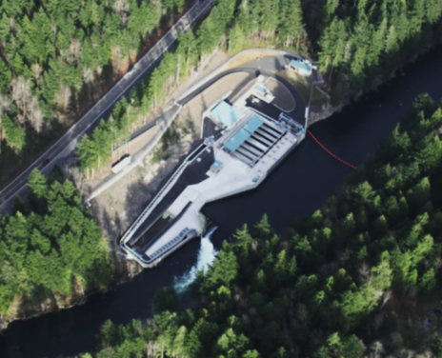
Minto Fish Facility: North Santiam
50 salmon radio-tagged at Minto
  20 (40%) fell back
  33 (66%) detected at Big Cliff
14 tagged at WIL Falls detected at Minto
  6 (43%) fell back
  10 (71%) at BC
First redd date
● Fallbacks a mix of pre- and post-spawn events
● Minto to Big Cliff travel time = ~70 d, on median
● Minto to fallback time = ~50 d, on median
(range = 0 – 115 d)

Slide 28

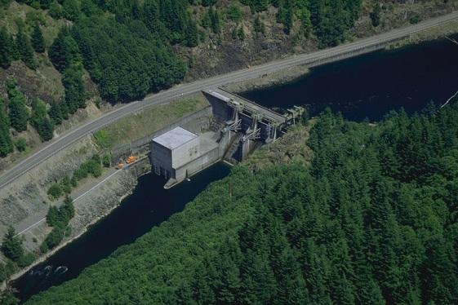

Summary
Prespawn mortality
  Fall Creek: Temperature, tag date & size effects
  NFMF: increasing mortality with late tag date
  S Santiam: ~17%, comparable to NFMF
Foster Reservoir releases
  Extended holding
  Thermal benefit compared to river
  But: high fallback rate (23% reservoir vs 0% river)
Minto releases (preliminary)
  Staging behaviors, most fish to Big Cliff
  High fallback rates a mix of
  pre- and post-spawn events
Notes:
Updated. I tried to keep this to one slide but may want another

Slide 29
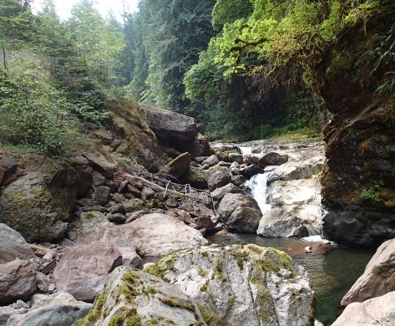
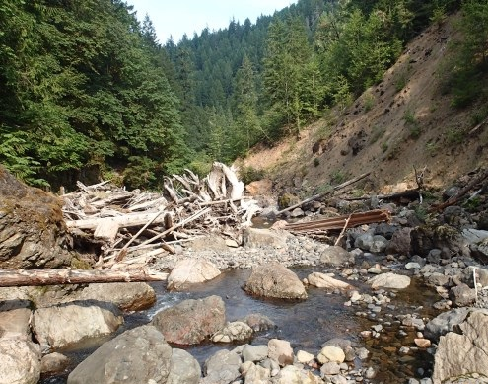
Questions?

Slide 30
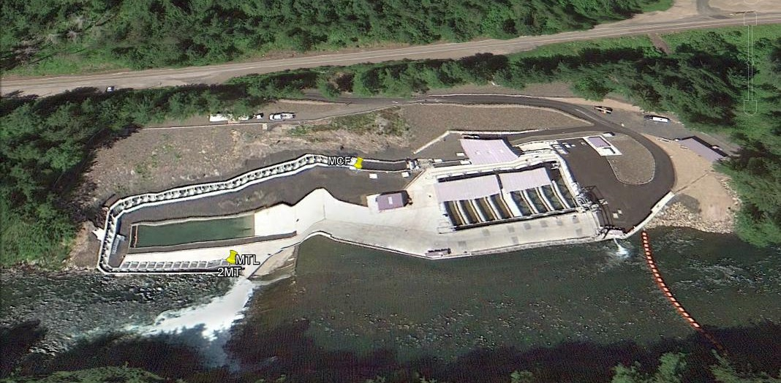
Summer Steelhead Detected >Minto Collection Facility - 2014
Angler recaptures reported near Big Cliff (G. Grenbemer pers. comm.)
34 summer SH r-tagged at W. Falls detected in N. Santiam R.
3 detected upstream from Minto at Big Cliff Dam (~9%)
All 3 SH migrated below Minto by early Sept. 2014
Semi-permeable membrane?

